Slide 1
Lecture 13: Placement – III
Tsung-Wei (TW) Huang
Department of Electrical and Computer Engineering
University of Utah, Salt Lake City, UT

Slide 2
Programming Assignment #2
Deadline is extended to 11/17 23:59 PM
https://github.com/tsung-wei-huang/ece5960-physical-design/issues/3
Checkpoint due on every Wed until 11/17
https://github.com/tsung-wei-huang/ece5960-physical-design/issues/4
Implementation details
Slicing tree: parenthesis checking algorithm
Sequence pair: shortest path implementation
Simulated annealing-based optimization

Slide 3
Recap: Analytical Placer
Write an equation whose minimum is the placement
If you have a million gates, need a million (xi, yi) values as result
Formulate an appropriate cost function for all the gate-level (xi, yi): F( x₁, x₂, … x_{1M}, y₁, y₂, … y_{1M})
Solve analytically for X*=(x₁, x₂, … x_{1M}), Y*=(y₁, y₂, … y_{1M}) to minimize F( )
The resulting values of X*, Y* give you the placement of all 1M gates
This sounds sort of crazy… but it works great
All modern placers for big ASICs and SOCs are “analytical”
Big trick is write the wirelength in mathematically “friendly” form we can optimize

Slide 4
Recap: Quadratic Wirelength Model
We optimize squared length of “distance” line between points: (x1-x2)² + (y1-y2)²
A “2-point net”
Quadratic wirelength
=(3-1)² + (4-1)²
=13
y=5
4
3
2
1
0
For k-point net, we use the clique model (complete graph for each net)
x= 0 1 2 3 4

Slide 5
Recap: Quadratic Placement Formulation
(0, 1)
(1,1)
1
0 1 10 0 0
1 0 1 1 1
10 1 0 1 0
0 1 1 0 1
0 1 0 1 0
21 -1 -10 0 0
-1 4 -1 -1 -1
-10 -1 13 -1 0
0 -1 -1 4 -1
0 -1 0 -1 3
3
C =
A =
4
Weight=10
5
2
Weight=10
b_{x} = 0
0
1
1
0.5
b_{y} = 10
0
0
1
0
(1,0)
(0.5,0)
All wire weights = 1 except two highlighted:
gate1 to pad and gate1 to gate2

Slide 6
Recap: Quadratic Placement Result
Placement → Solving a linear system

Slide 7
Recap: What is Matrix A?
Surprisingly simple recipe to build the required A matrix
First, build the NxN connectivity matrix, called C
If gate i has a 2-point wire to gate j with weight w, c[i,j] = w, else = 0
Another example of 3 gates, 3 wires, and 1 I/O pad (P)
5
P
1
1
2
C =
0 1 0
1 0 4
0 4 0
4
Note: C matrix ignores the pads
3
Notes:
Of course, we derive the matrix by hand, you know, Ax=bx and Ay=by. But, how do we calculate the matrix systematically? (explain..)
For example, here I have a placement problem of three nets and three gates, and one pad. Keep in mind, pad is a fixed element in the placement region that cannot be moved. Gates 1, 2, 3, are to be moved to minimize the wirelength.
Here I have three nets, quite simple, all 2-pin nets. Net one has a weight of 5 connecting gate 1 to the pad (explain …)
The C matrix for this example is as follows. It’s a square matrix, each column and row index represent the gate. Basically it is adjacency matrix. As long as there is a connection between gates, we will put the weight of its net.

Slide 8
Recap: What is Matrix A? (cont’d)
Use the connectivity C matrix to build A matrix
Elements a[i,j] not on the matrix diagonal are just a[i,j] = -c[i,j]
Elements on the diagonal are a[i,j]= ∑_{j=1,n} c[i,j] + (weight of any pad wire)
…ie, add up the i^{th} row of C and then add in weight on a (possible) wire to pad
Note: A matrix accounts for pads
5
P
1
1
2
C =
0 1 0
1 0 4
0 4 0
A =
6 -1 0
-1 5 -4
0 -4 4
4
3
diagonal
Notes:
Then, what is the matrix A? Well, we use the connectivity C matrix to build A matrix. (explain…)

Slide 9
Recap: What is Vector b?
i
wi
(xi,yi)
For Ax = b_{x} vector:
If gate i connects to a pad at (xi, yi) with a wire with weight wi
Then set b_{x}[i] = wi • xi
For Ay = b_{y} vector:
If gate i connects to a pad at (xi, yi) with a wire with weight wi
Then set b_{y}[i] = wi • yi
A
x
=
b_{x}
A
y
=
b_{y}
i^{th} element of b_{x} vector
i^{th} element of b_{y} vector
Notes:
Now, we are good for the square matrix A. What is the vector b? (explain Ax=bx and Ay=by)

Slide 10
Recap: Revisited
(0, 1)
(1,1)
1
0 1 10 0 0
1 0 1 1 1
10 1 0 1 0
0 1 1 0 1
0 1 0 1 0
21 -1 -10 0 0
-1 4 -1 -1 -1
-10 -1 13 -1 0
0 -1 -1 4 -1
0 -1 0 -1 3
3
C =
A =
4
Weight=10
5
2
Weight=10
b_{x} = 0
0
1
1
0.5
b_{y} = 10
0
0
1
0
(1,0)
(0.5,0)
All wire weights = 1 except two highlighted:
gate1 to pad and gate1 to gate2

Slide 11
Recap: How to Solve Ax=b?
Are these difficult to do, in practice?
If we have 1M gates, this is a 1M x 1M A matrix, with 1M element x and b vectors!
No – these are VERY EASY to solve, even when very large
The A matrix has a special form—it is sparse, symmetric, diagonally dominant
Mathematically: A is positive semi-definite—very simple to solve!
We use iterative, approximate solvers, in practice (i.e., not Gaussian elimination but techniques like conjugate gradient)
This means the solver converges gradually to the right answer
But, also means that the answers can be a little bit “off”, not quite perfect
Notes:
Now we have the matrix A and b, a linear system described in matrix form. How do we solve it? You know the matrix is pretty big in practice, for example, if we have 1M gates, this is a 1M by 1M matrix in A with 1M element x and b vectors, same for y!
Well, turns out these are not difficult at all, thanks to the advancement of computing, these equations are very easy to solve, even when the problem is very large. (explain …)

Slide 12
Practice #1: What are C, A, bx, and by?
(0, 1)
(1,1)
1
3
C =
A =
4
2
5
b_{x} =
b_{y} =
(1,0)
(0.5,0)
All wire weights = 1

Slide 13
Practice #2: What are C, A, bx, and by?
(0, 1)
(1,1)
1
3
C =
A =
4
2
5
b_{x} =
b_{y} =
(1,0)
(0.5,0)
All wire weights = 1

Slide 14
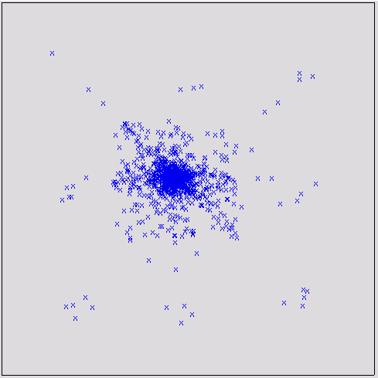
Takeaway
When no pads exists
b vectors become zero
Solutions of x and y degenerate to all zero
trivial solutions
All points lump together – many overlaps
New problem
Quadratic model minimizes wirelength for big netlists, in a numerical way
But ignores that gates have physical size, cannot be on top of each other
Now, we have to fix this
Notes:
Now we have the matrix A and b, a linear system described in matrix form. How do we solve it? You know the matrix is pretty big in practice, for example, if we have 1M gates, this is a 1M by 1M matrix in A with 1M element x and b vectors, same for y!
Well, turns out these are not difficult at all, thanks to the advancement of computing, these equations are very easy to solve, even when the problem is very large. (explain …)

Slide 15
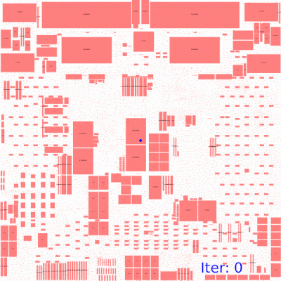
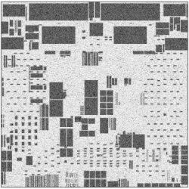
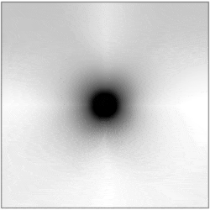
Artificial Pads for b Vectors
https://github.com/limbo018/DREAMPlace

